Slide 1

uNit 6 – Network operating systems
Computing Systems
Notes:
Hola pepsicola!

Slide 2
Index
Network operating systems
Operative system Windows Server
Windows domain
Active Directory
Domain Controller
Preparing Scenario
Bios setup
Hyper-V
Virtual Box
Install Windows 2019
Server Manager
Rename Server
Add role
Promote Server
Add RODC Server
Administration
Connect to Domain Controller
Nat Network
Join to Domain
DHCP
Users and Groups

Slide 3
Operative system Windows Server
Most widespread today.
With graphical interface.
Multitasking and multiuser.
SMP, Symmetric Multi-Processing.
DOS (8 bits) and apps Windows from 16, 32 and 64 bits.
There are Windows Server distributions that can be used in clusters.
Hardware abstraction.
Can use (as secondary file system) ReFS or Resilient File System from Windows Server 12R2.
Download ISO Windows Server 2019 English Version
Download ISO Windows Enterprise 10 English Version

Slide 4
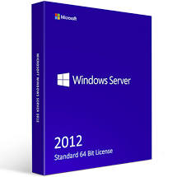
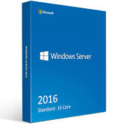

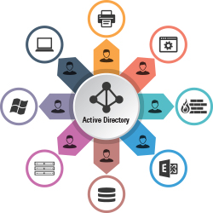
Windows domain
It is a form to administrate a computer network. Authentication takes place on domain controllers and all are registered with a central database located on one or more clusters of central computers.
NetBiosName.domain
Domain controller
It is any Windows server (Computer or PC) that has the domain controller role installed. Each domain controller stores a copy of the Active Directory database, which contains information about all objects within the same domain.
Active Directory
It is a directory service that manages a hierarchically organized database in order to easily manage the resources of a network, storing information on each element of the network in a structured way, which facilitates the process search for resources and authentication within the network.

Slide 5
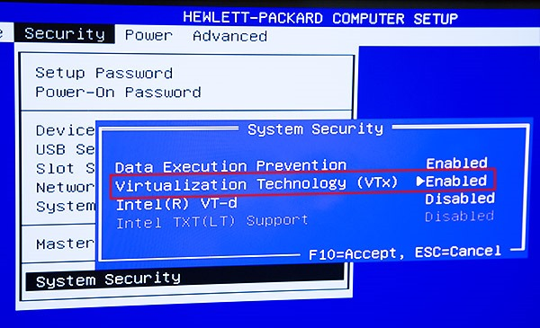
Preparing Scenario
Bios Virtualization On
Hyper-V
Virtual Box
Install Windows 2019
BIOS setup
Font:https://techcommunity.microsoft.com

Slide 6
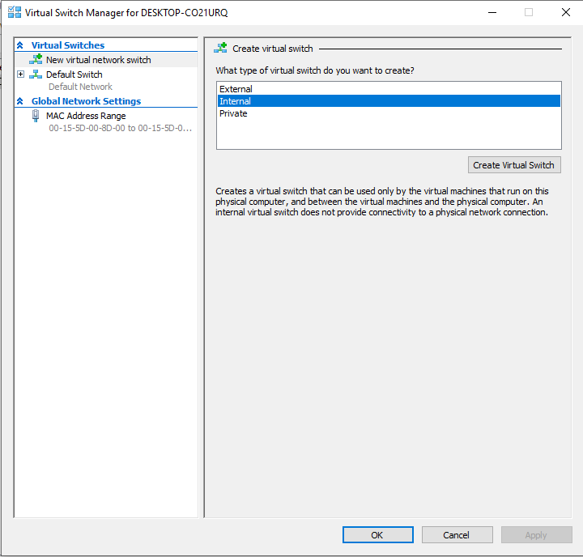
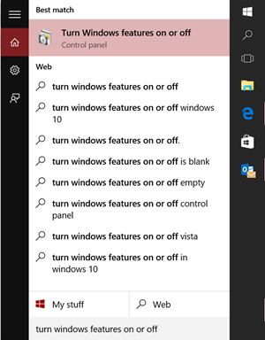
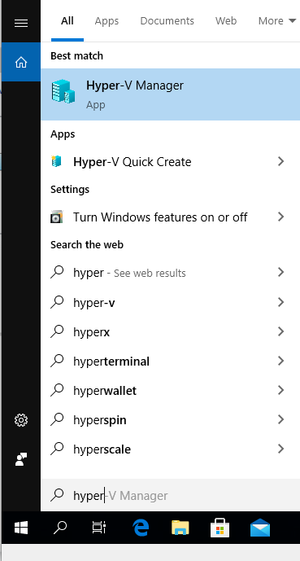
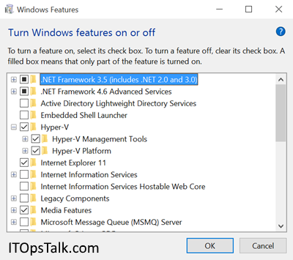
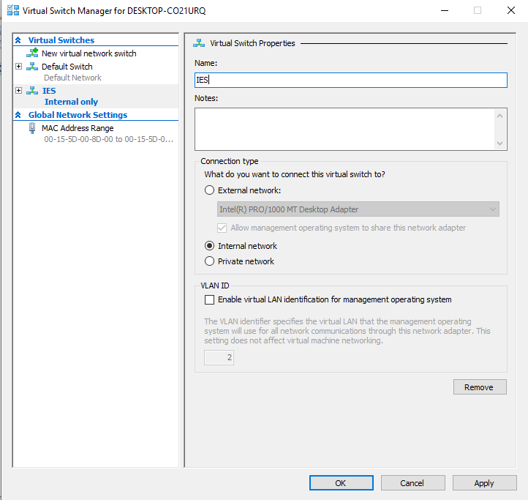

Bios Virtualization On
Hyper-V
Virtual Box
Install Windows 2019
GUI Hyper-V setup
Allow Hyper-V en Windows 10 Professional, Educational or Enterprise
PowerShell
Enable-WindowsOptionalFeature -Online -FeatureName Microsoft-Hyper-V -All
CMD
DISM /Online /Enable-Feature /All /FeatureName:Microsoft-Hyper-V

Slide 7
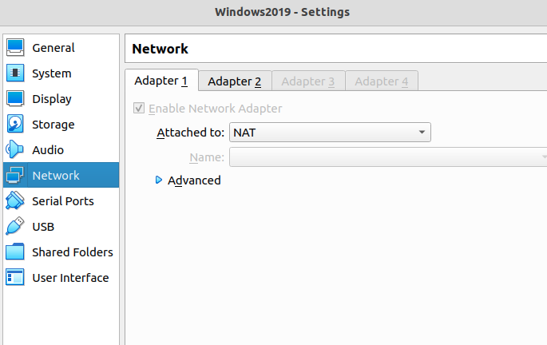
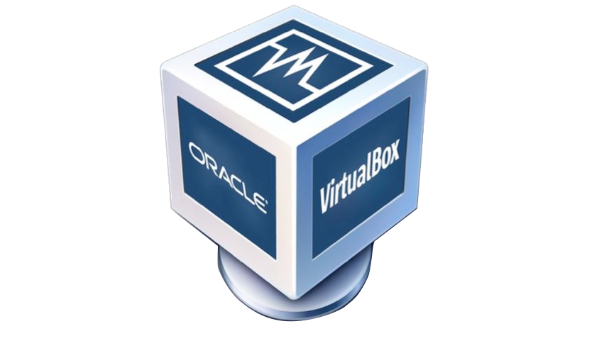
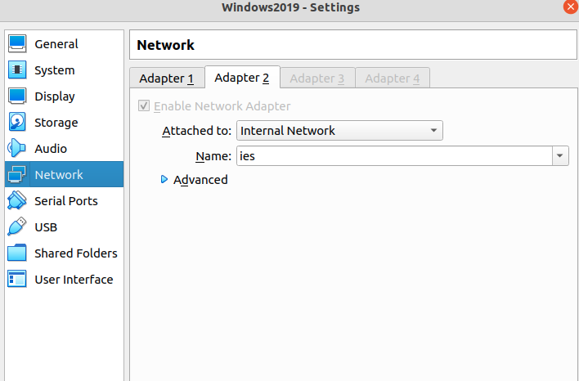
Bios Virtualization On
Hyper-V
Virtual Box
Under VBox setup

Slide 8
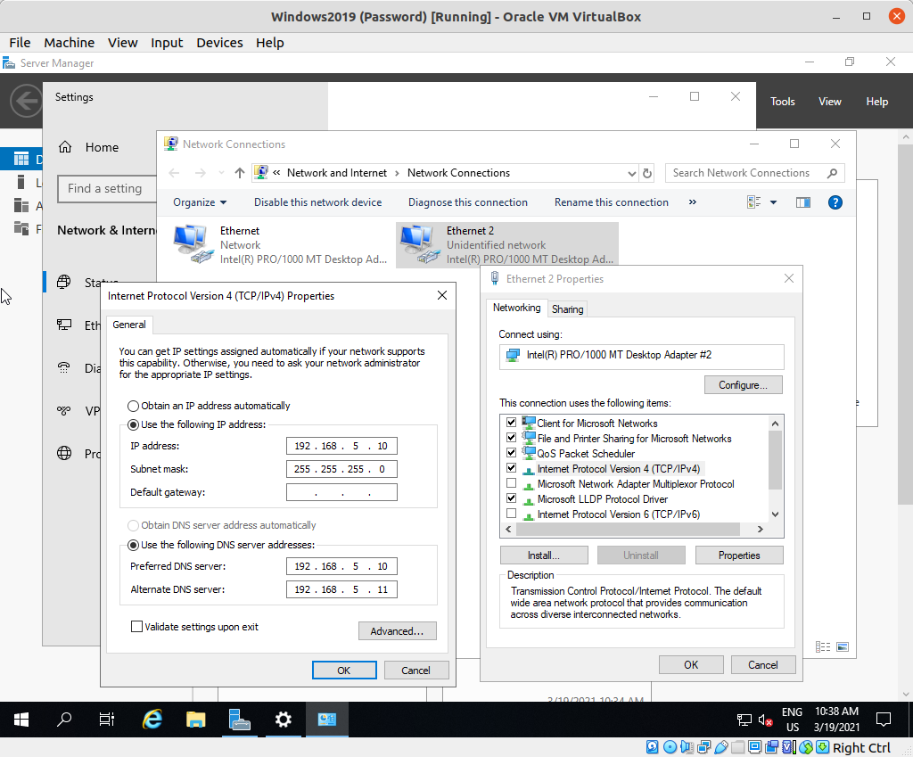
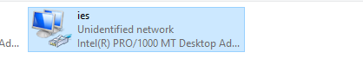
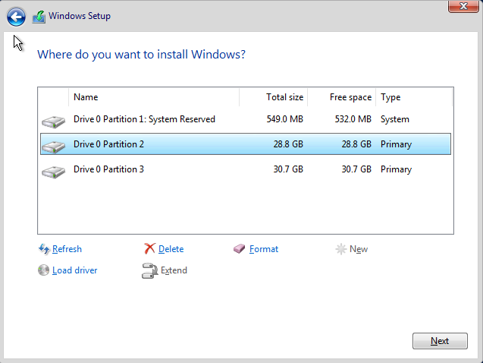
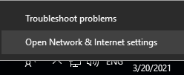
Windows 2019 VM
Name: S1
Generation: 2
Standard Edition GUI
RAM: 2048
Drive: 30GB+30GB
PasswOrd: Pa$$w0rd
Win+R and ncpa.cpl

Slide 9
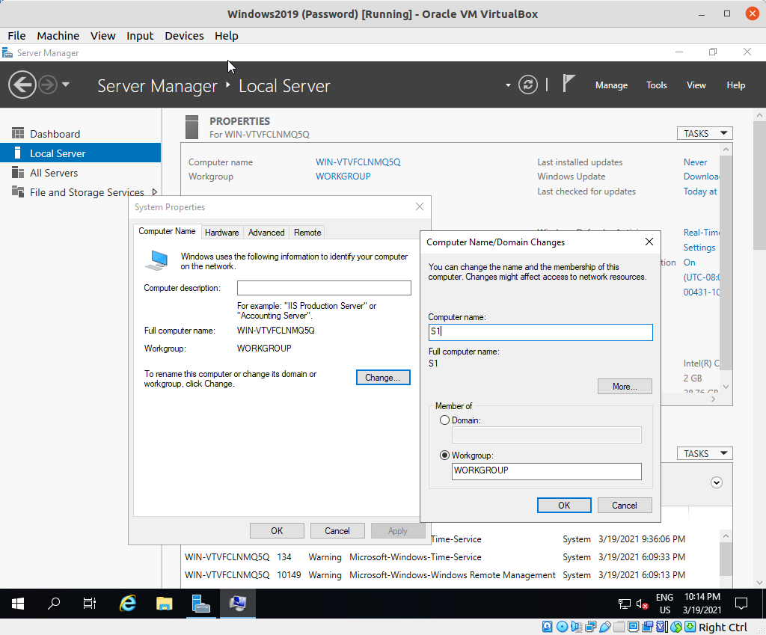
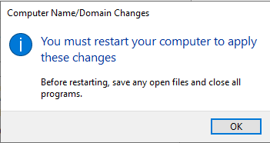
Server Manager
Change name
Add role Active Directory Domain Services
Promote Server
Add RODC Server
1
2
3
4
5

Slide 10
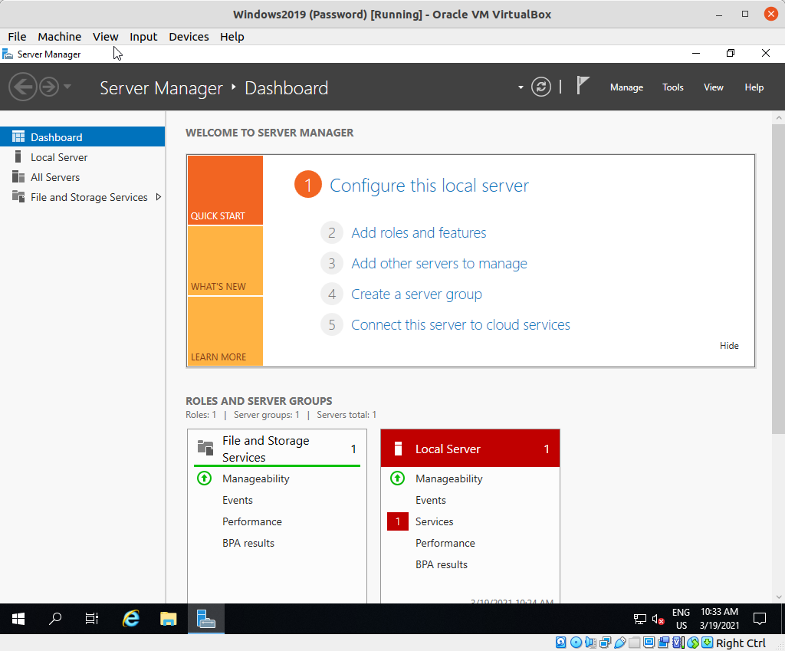
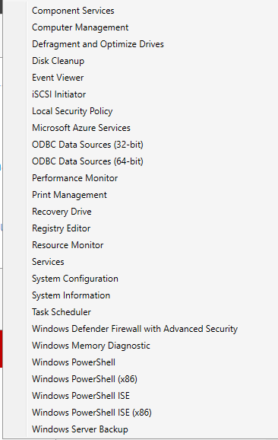
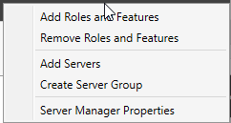
Change name
Add role Active Directory Domain Services
Promote Server

Slide 11
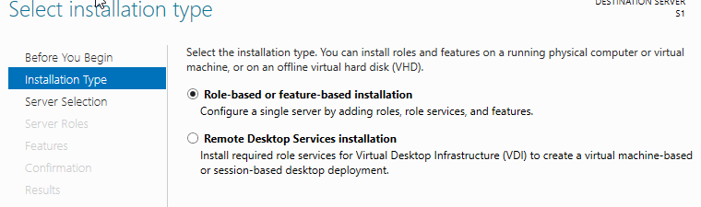
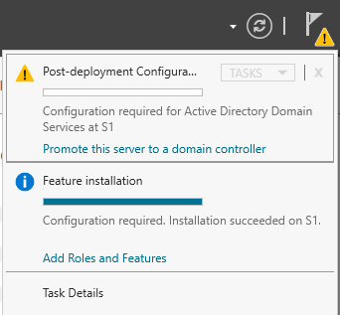
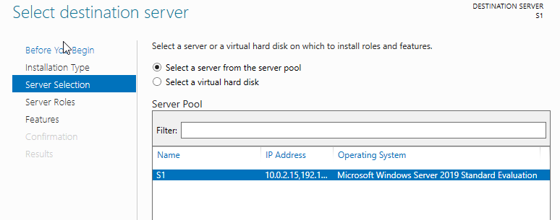
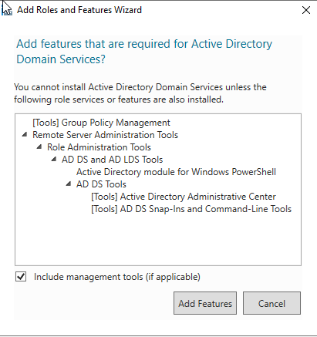
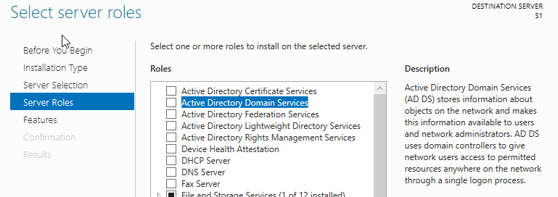

Slide 12
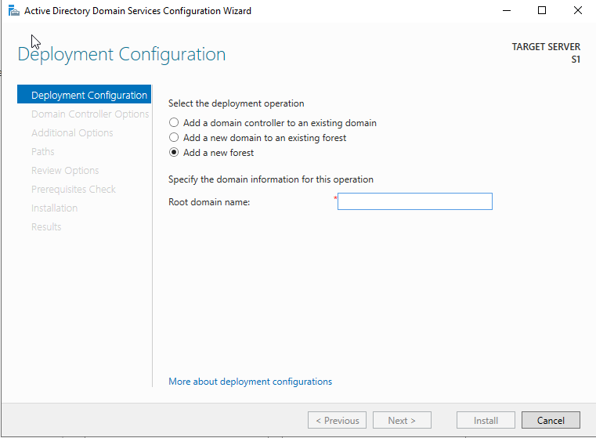
Change name
Add role Active Directory Domain Services
Promote Server
Forest
A forest is a collection of one or more AD domains, the first one installed is called the root domain.
eljust.ies
domainName.domainExtension

Slide 13
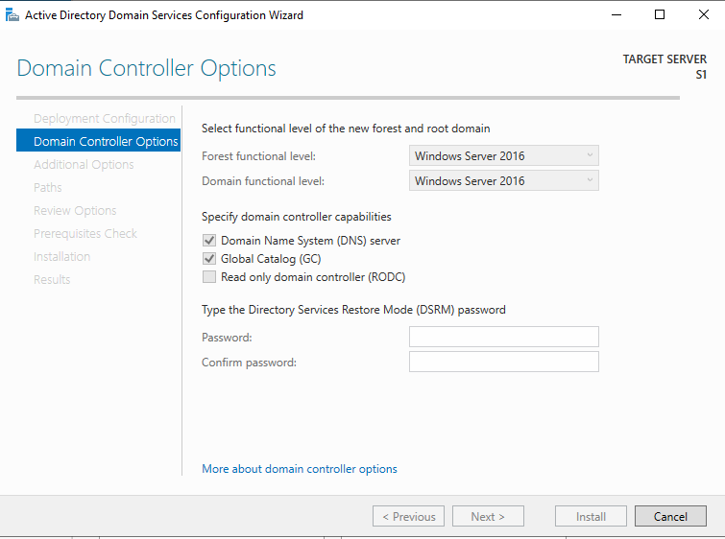
Functional Level
It allows the activation of one or more features for a domain or forest. All domain controllers are required to run the operating system corresponding to the selected functional level.
DNS
Domain name server is required. Let install one with the server's promotion to domain controller.
Pa$$w0rd

Slide 14
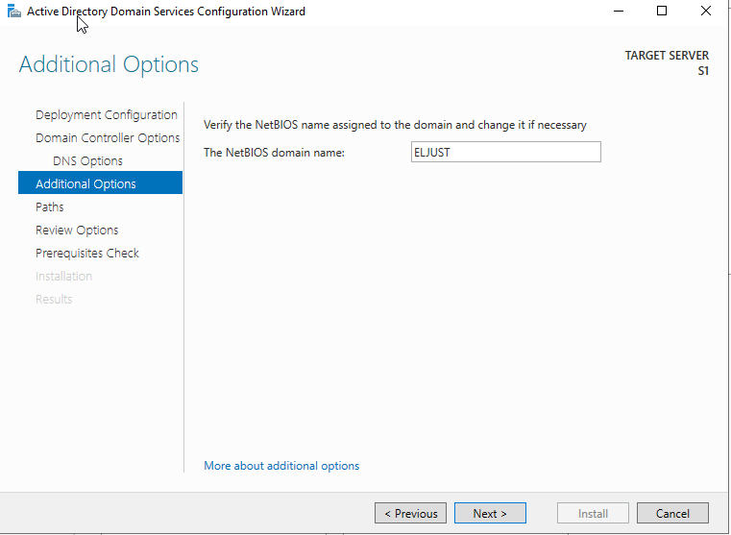
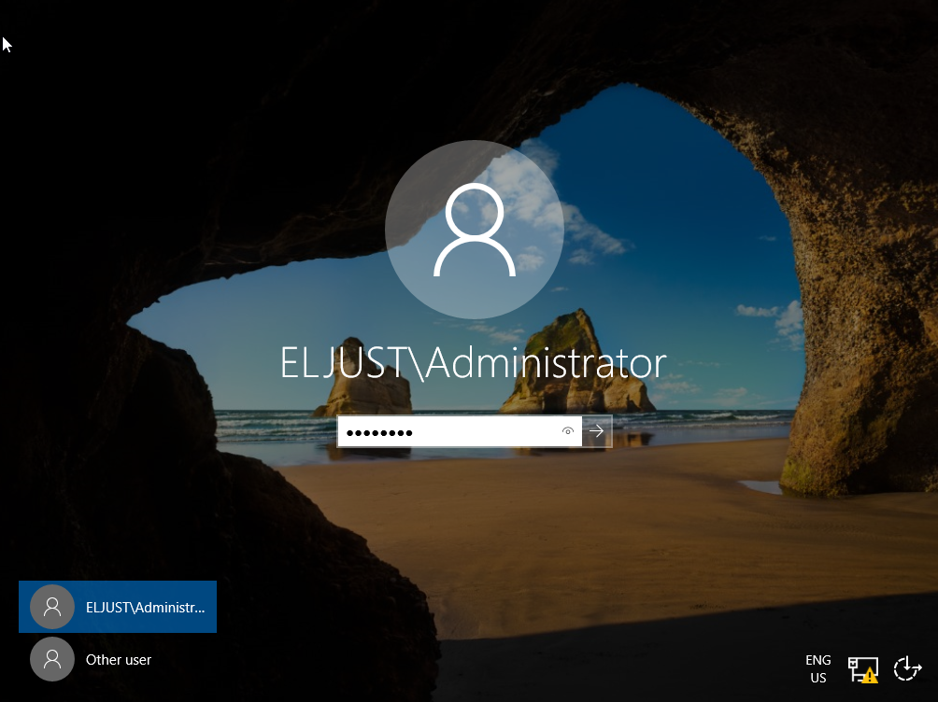
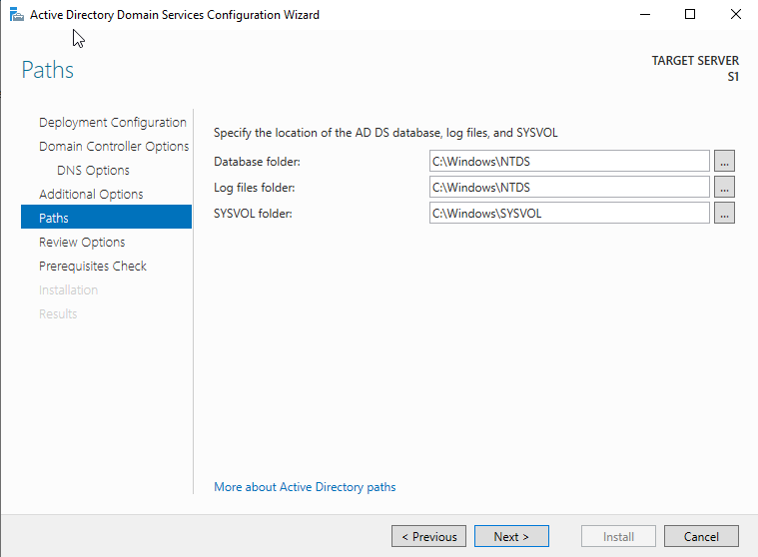
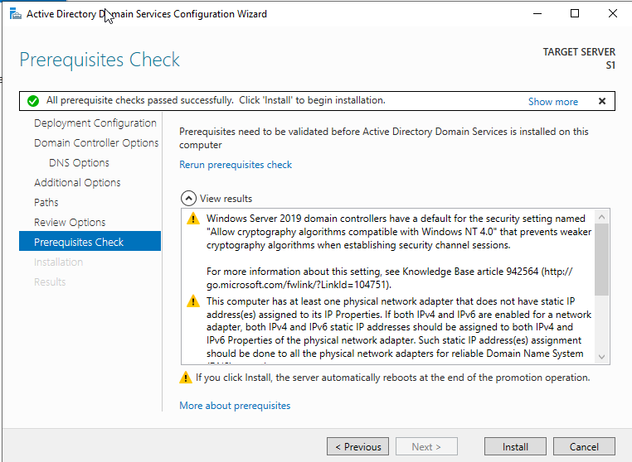
All default options, install and reboot!!!

Slide 15
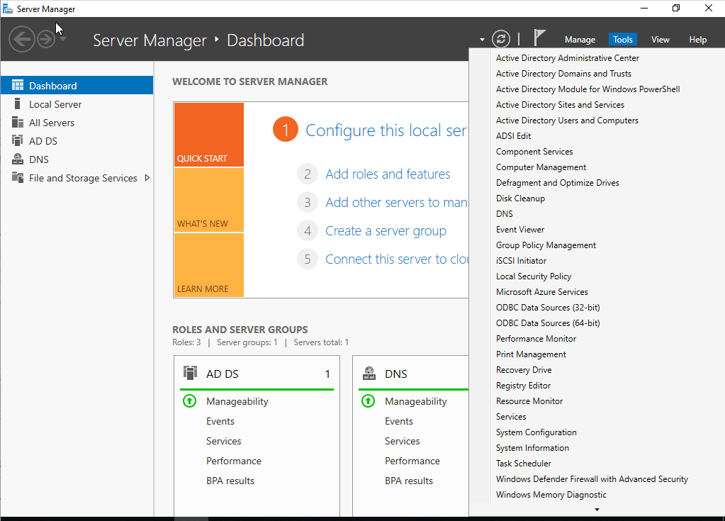
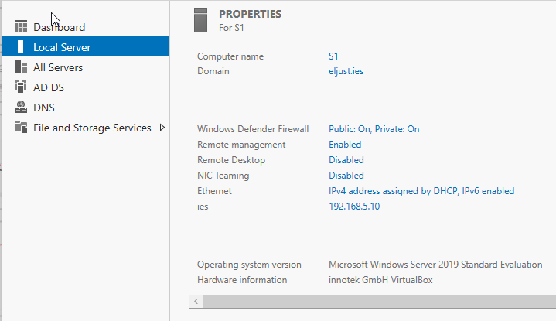

Slide 16
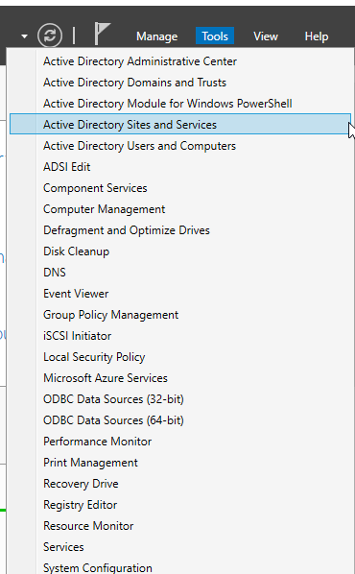
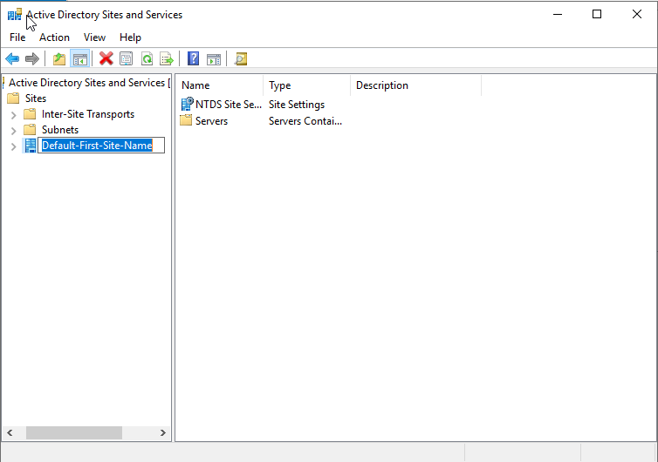
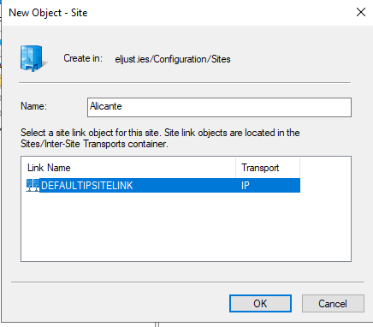
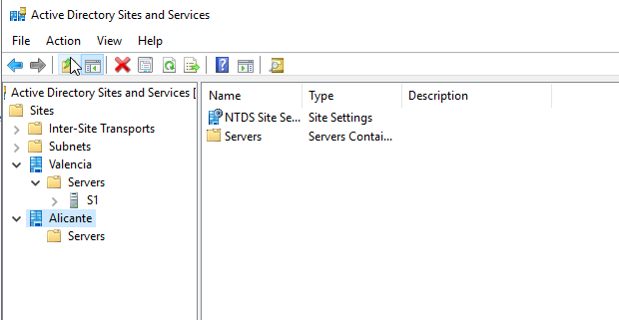
Add Read Only Domain Controller (RODC) Server

Slide 17
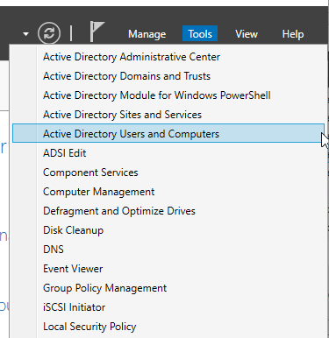
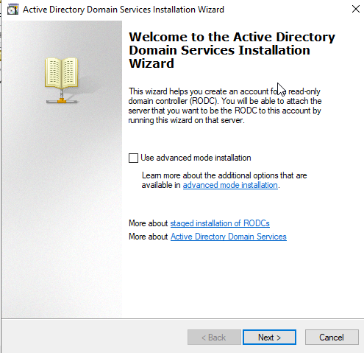
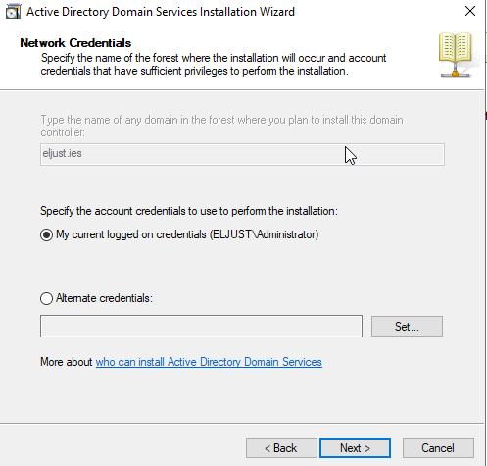
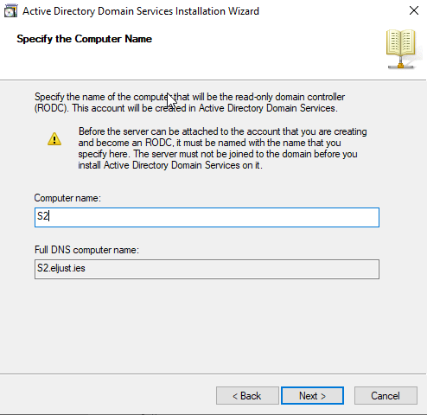
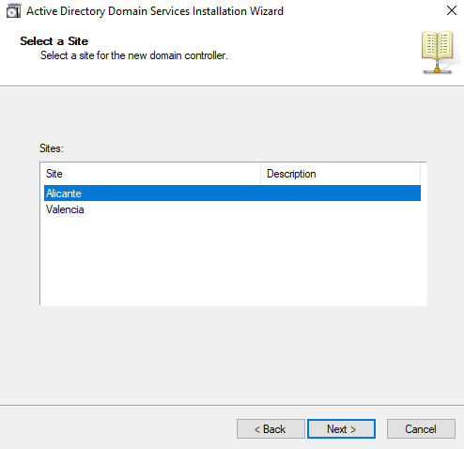
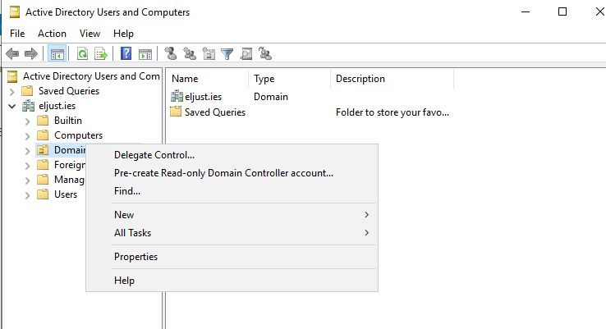
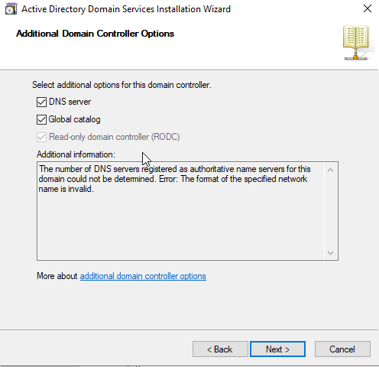
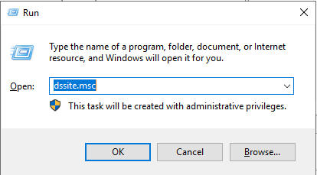

Slide 18
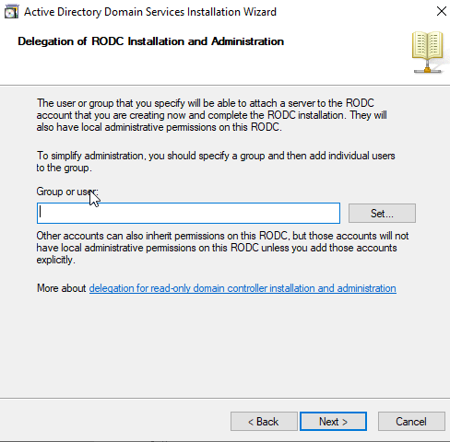
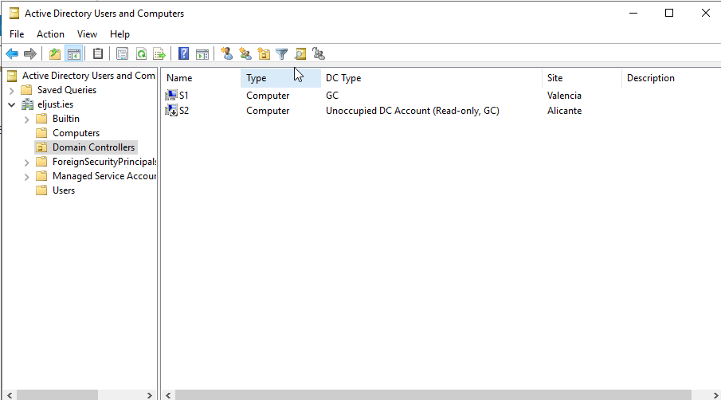
Now create S2 and promote to DC with adding to an existing domain

Slide 19
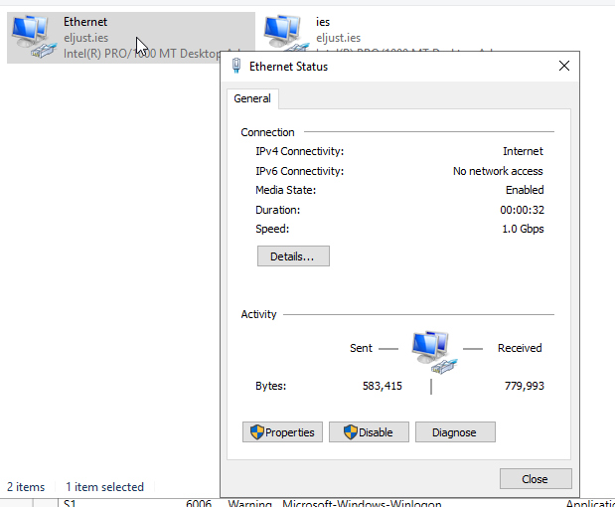
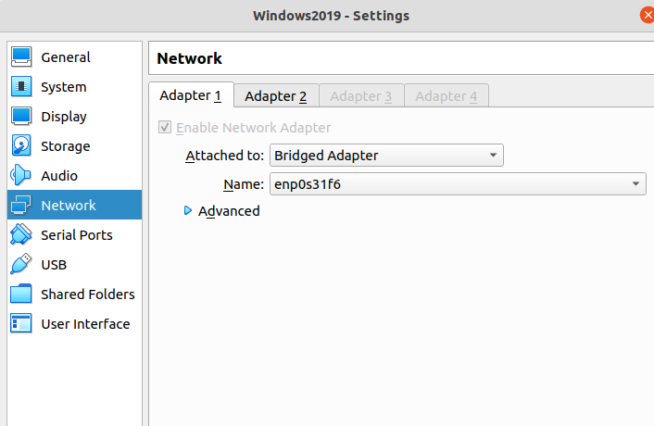

Administration
Connect to Domain Controller
Nat Network
Join to Domain

Slide 20




Slide 21




NetBiosName.domain

Slide 22



Connect to Domain Controller
NAT Network
Join to Domain
1
2
3

Slide 23







Slide 24


Slide 25





Connect to Domain Controller
NAT Network
Join to Domain
Do this in two steps

Slide 26

Win+Pause

Slide 27

Connect to Domain Controller
NAT Network
Join to Domain
Dynamic Host Configuration Protocol (DHCP)

Slide 28



Slide 29



Slide 30






Slide 31





Slide 32


Slide 33
Arborescence and objects
Objects
Organizational units (OU)
Users
Groups
Devices
Printers
eljust.ies
amapa.ies
LDAP
dc=ies
education.eljust.ies
administration.eljust.ies
dc=eljust, dc=ies
Domain considerations
Represents a security boundary where users are defined.
At least one Domain Controller but another is highly recommended.
Relationship father/son between domains with same arborescence.
OU
Container type object.
Allows to build a hierarchy.
Object are grouped by applying group policy object (GPO).
Administration can be delegated. Users can change their password.
dc= education, dc=eljust, dc=ies
ou=SMX
ou=DAW
ou=SI
CN = Common Name
OU = Organizational Unit
DC = Domain Component
cn=Jane
cn=Albert

Slide 34



eljust.ies
dc=ies
dc=eljust, dc=ies
ou= education, dc=eljust, dc=ies
ou=DAW

Slide 35


Objects
Organizational units (OU)
Users
Groups
Devices
Printers
dc=ies
dc=eljust, dc=ies
ou= education, dc=eljust, dc=ies
ou=DAW
ou=SI
cn=Jane
cn=Albert

Slide 36




dsadd user <”rising branch”> [-pwd] [-ln] [-fn] [-canchpwd] [-memberof]
-pwd
-ln
-fn
-canchpwd
-memberof
<Password>
<Las Name>
<User Name>
<yes|no> Obligation to change password on first login
<”cn=group, cn=group2 ou= ...”> Groups which the user is a member and branch
dsrm <”rising branch”>
DSADD to massive import

Slide 37


CVSDE to massive import or export
UserAccountControl
Property flag
ACCOUNTDISABLE | 0x00002 | 2
PASSWD_NOTREQD | 0x00020 | 32
PASSWD_CANT_CHANGE | 0x00040 | 64
NORMAL_ACCOUNT | 0x00200 | 512
DONT_EXPIRE_PASSWORD | 0x10000 | 65536
Can’t set
Passwords
0x200 = normal account
0x020 = password not required
0x002 = account disabled
0x222 in decimal 546

Slide 38



LDIFDE to massive import
Can’t set
Passwords

Slide 39




New-ADUser and Enable-ADAccount

Slide 40



Objects
Organizational units (OU)
Users
Groups
Devices
Printers
Active Directory
email list
Universal
eljust.ies
amapa.ies
Global A
Global B

Slide 41




Objects
Organizational units (OU)
Users
Groups
Devices
Printers
Steps to add a Raspbian to Domine
1
2
https://github.com/BeyondTrust/pbis-open/releases

Slide 42



3
Be carefully with /etc/resolv.conf
4
5

Slide 43



6
7

Slide 44


8

Slide 45





Objects
Organizational units (OU)
Users
Groups
Devices
Printers
https://pdfcreator.uptodown.com/windows/descargar/43392

Slide 46








Slide 47



Slide 48






Slide 49





Slide 50




Slide 51





Slide 52








root

Slide 53







Slide 54
To finish....
Thanks!

